Slide 1
Advanced Analytical Chemistry 1
Separation Technique, Chromatography
For Postgraduate (Master's degrees)
Lecture No. 5
By
Asst. Prof. Dr. Layla Salih Al-Omran

Slide 2
High Performance Liquid Chromatography (HPLC)
Formerly called high-pressure liquid chromatography, was developed from classical column liquid chromatography.
The separation principle of HPLC is based on the distribution of the analyte (sample) between a mobile phase (eluent) and a stationary phase (packing material of the column).
Each component in the sample interacts differently with the adsorbent material of the stationary phase, causing different flow rates for the different components and leading to the separation of the components as they flow out of the column.

Slide 3
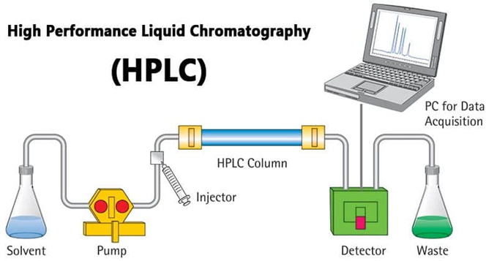
HPLC instrumentation consists
The basic HPLC instrumentation consists of pump(s), injector (manual or automatic injection), column(s), detector, and a data handling device, as shown in the figure below.

Slide 4
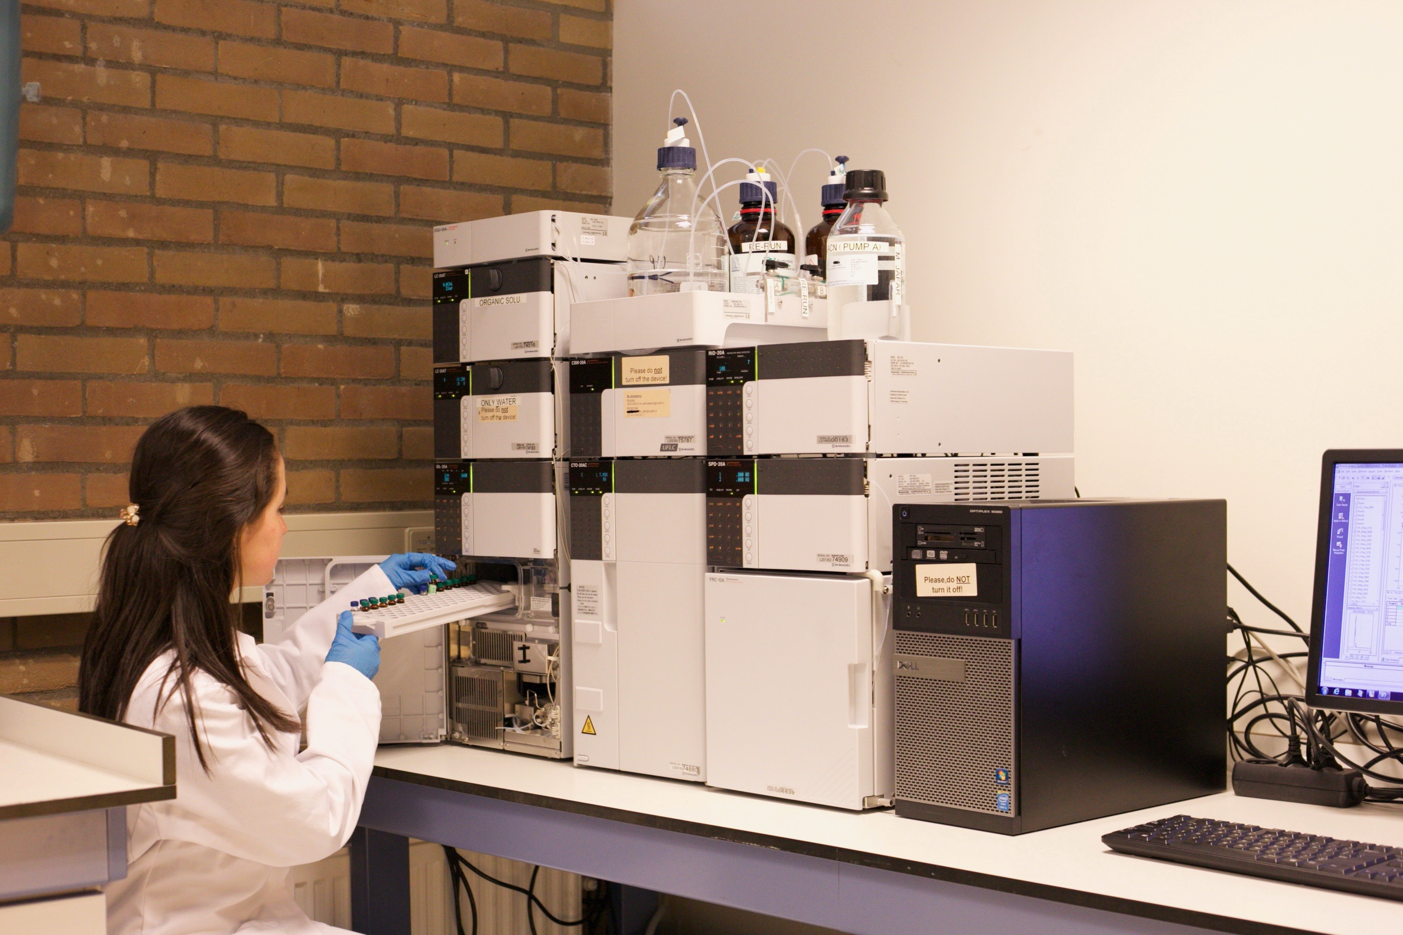

Slide 5
Features of HPLC
HPLC is distinguished from traditional ("low pressure") liquid chromatography because operational pressures are significantly higher(50–350 bar)
In low pressure liquid chromatography typically relies on the force of gravity , resulting in a slow flow rate and largely limiting the size of particles being used in column.
Relies on pumps to pass a pressurized liquid through the column, which greatly reduces the time of separation and thus increases efficiency.

Slide 6
small sample amount (typical 10 up to 100 μl) separated in analytical HPLC
The columns are made with smaller adsorbent particles. This gives HPLC superior resolving power, which makes it a popular chromatographic technique.

Slide 7
Solvent
Normal Phase Chromatography - separation uses non-polar solvents such as Chloroform, Hexanes, cyclohexane, etc. Reverse Phase Chromatography - separation uses polar solvents such as methanol, acetonitrile, water, etc.
Column
If a species interacts more strongly with the stationary phase in the column, it will spend more time adsorbed to the column's adsorbent and will therefore have a greater retention time.
Columns can be packed with solids such as silica or alumina; these columns are called homogeneous columns. If stationary phase in the column is a liquid, the column is a bonded column. Bonded columns contain a liquid stationary phase bonded to a solid support, which is usually silica or alumina.

Slide 8
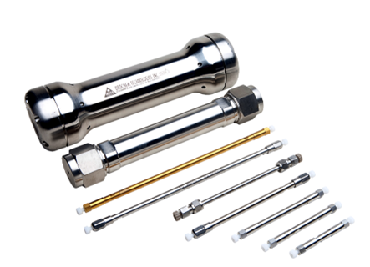
Different Types of HPLC Columns Used in Analysis
Normal Phase Columns.
Reverse Phase Columns.
Ion Exchange Columns.
Size Exclusion Columns
Column dimensions are 2.1–4.6 mm diameter, and 30–250 mm length. Also, HPLC columns are made with smaller adsorbent particles (2–50 μm in average particle size).

Slide 9
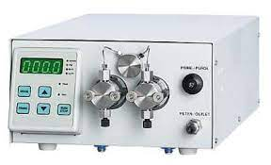
Pump
The HPLC pump drives the solvent and sample through the column. To reduce variation in the elution,
the pump must maintain a constant flow rate, this is achieved with multi-piston pumps.
The presence of two pistons allows the flow rate to be controlled by one piston as the other recharges.
A syringe pump can be used for even greater control of flow rate; however, the syringe pump is unable to produce as much pressure as a piston pump, so it cannot be used in all HPLC applications.

Slide 10
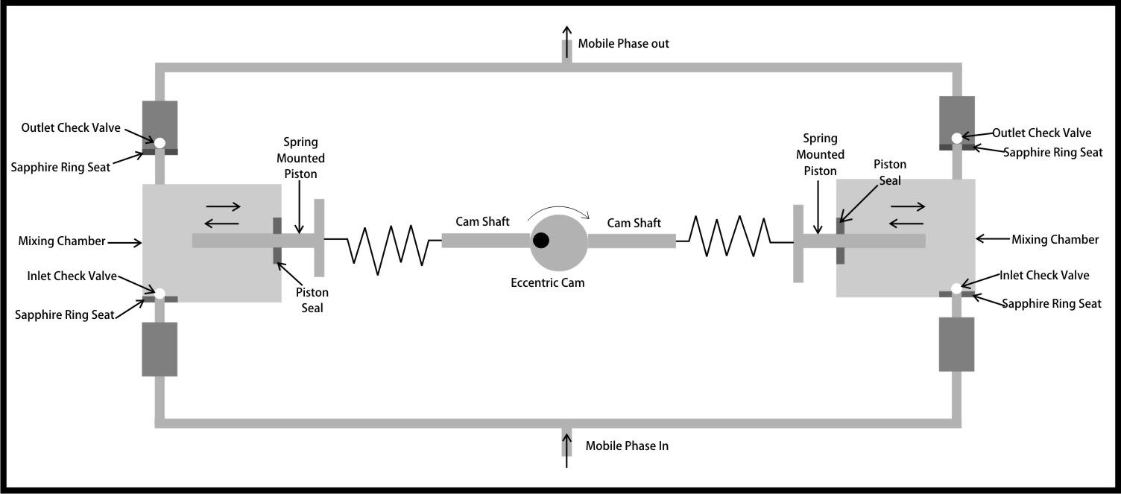

Slide 11
Detector
The HPLC detector, must register the presence of various components of the sample, but must not detect the solvent.
For that reason, there is no universal detector that works for all separations.
UV absorption detector, as most medium to large molecules absorb UV radiation.

Slide 12
Fluorescence and refractive index are also used for special applications.
Combination of an HPLC separation with mass spectrometry.
NMR detectors, allows the pure components of the sample to be identified and quantified by nuclear magnetic resonance after having been separated by HPLC, in one integrated process.

Slide 13
Technique
Normal Phase vs. Reverse Phase
If the stationary phase is more polar than the mobile phase, the separation is deemed normal phase.
If the stationary phase is less polar than the mobile phase, the separation is reverse phase.
In reverse phase HPLC, the retention time of a compound increases with decreasing polarity of the particular species.

Slide 14
The key to an effective and efficient separation is to determine the appropriate ratio between polar and non-polar components in the mobile phase.
The goal is for all the compounds to elute in as short a time as possible, while still allowing for the resolution of individual peaks.
Typical columns for normal phase separation are packed with alumina or silica.
Alkyl, aliphatic or phenyl bonded phases are typically used for reverse phase separation.

Slide 15
2. Isocratic Elution vs Gradient Elution
The isocratic and gradient elution describes the properties of the mobile phase.
If the composition of the mobile phase remains constant throughout the HPLC separation, the separation is deemed an isocratic elution, means the mobile phase has a constant concentration.
In isocratic elution, the peak width increasing with retention time linearly in the chromatogram.
This leads to a disadvantage – the late-eluting peaks for late elution get very flat and broad. Therefore, these broad peaks become difficult to be recognized as peaks.

Slide 16
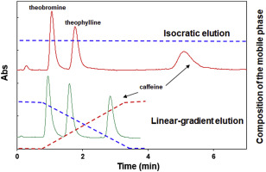
Gradient chromatography ; the concentration of well-retained solutes in the mobile phase is increased by constantly changing the composition, and hence the polarity, of the mobile phase during the separation.

Slide 17
For a reverse phase (n-p s.) gradient, the solvent starts out relatively polar and slowly becomes more non-polar. The gradient elution offers the most complete separation of the peaks, without taking long time.
A sample containing compounds of a wide range of polarities can be separated by a gradient elution in a shorter time period without a loss of resolution in the earlier peaks or excessive broadening of later peaks.
However, gradient elution requires more complex and expensive equipment and it is more difficult to maintain a constant flow rate while there are constant changes in mobile phase composition.

Slide 18
Applications of HPLC
HPLC can be used in both qualitative and quantitative applications, that is for both compound identification and quantification.
Normal phase HPLC is only rarely used now, almost all HPLC separation can be performed in reverse phase.
Reverse phase HPLC (RPLC) is ineffective in for only a few separation types; it cannot separate inorganic ions (they can be separated by ion exchange chromatography).

Slide 19
It cannot separate polynucleotides (they adsorb irreversibly to the reverse phase packing).
hydrophobic compounds cannot be separated effectively by RPLC (there is little selectivity).
RPLC is used for the separation of almost all other compound varieties. RPLC can be used to effectively separate similar simple and aromatic hydrocarbons, even those that differ only by a single methylene group. RPLC effectively separates simple amines, sugars, lipids, and even pharmaceutically active compounds. RPLC is also used in the separation of amino acids, peptides, and proteins.

Slide 20
Finally, RPLC is used to separate molecules of biological origin.
The determination of caffeine content in coffee products is routinely done by RPLC in commercial applications in order to guarantee purity and quality of ground coffee.
HPLC is a useful addition to an analytical arsenal, especially for the separation of a sample before further analysis.

